Slide 1
Piping Analysis Examples
Vibration Analysis and Modification Design Video found on our website: https://www.youtube.com/watch?v=TZjbzLzf0Pw&feature=youtu.be
12141 Wickchester Lane, Suite 700 • Houston, TX 77079 • (713) 462-3636

Slide 2
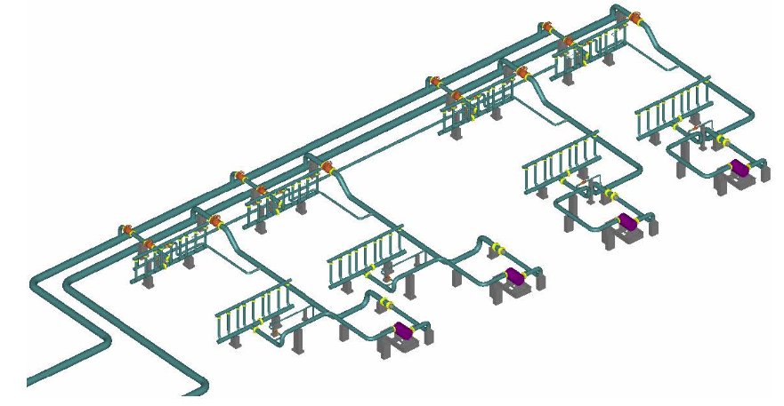
Piping Analysis Services
API 617

Slide 3
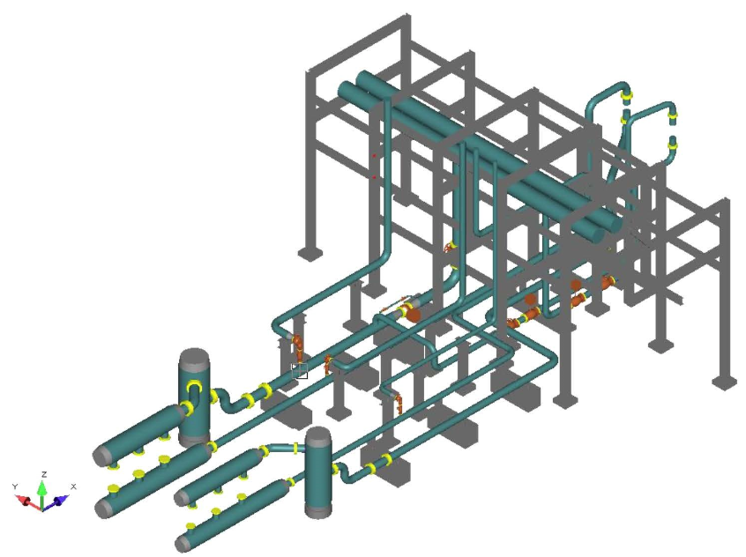
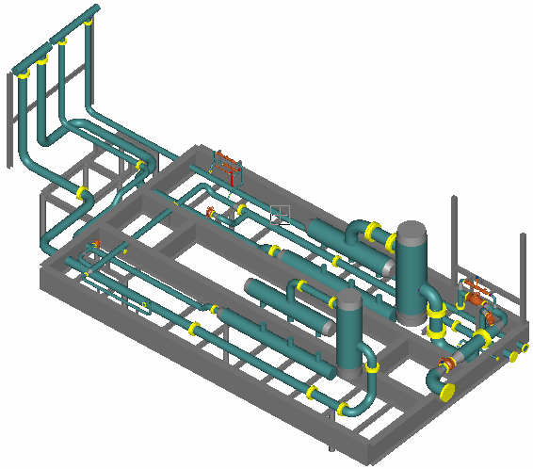
Piping Analysis Services
API 618

Slide 4
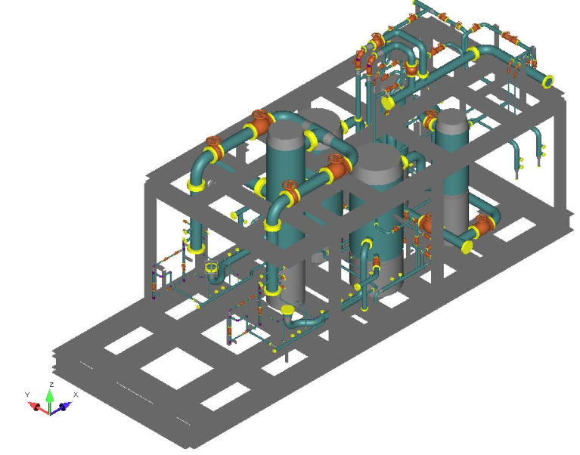
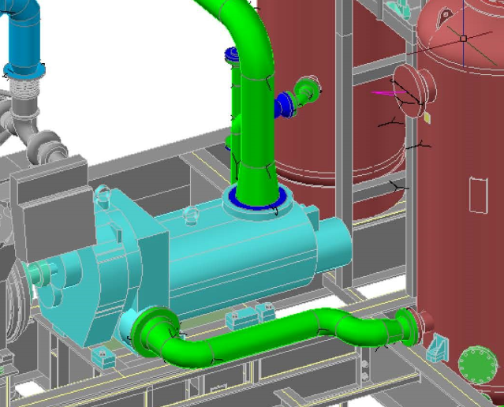
Piping Analysis Services
API 619

Slide 5
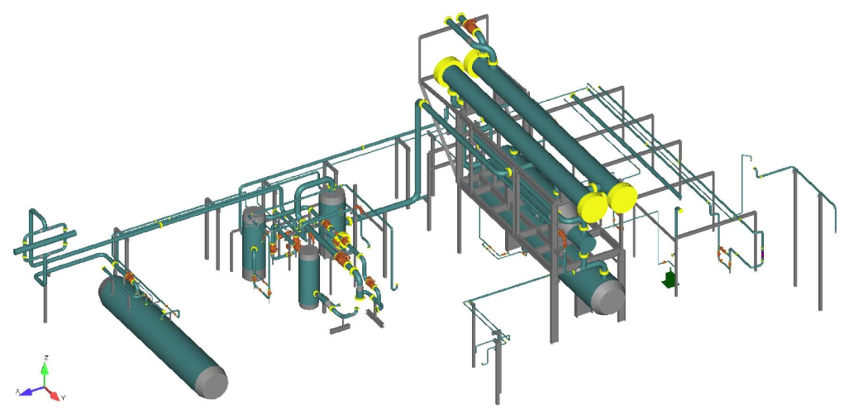
Piping Analysis Services
ASME B31.3

Slide 6
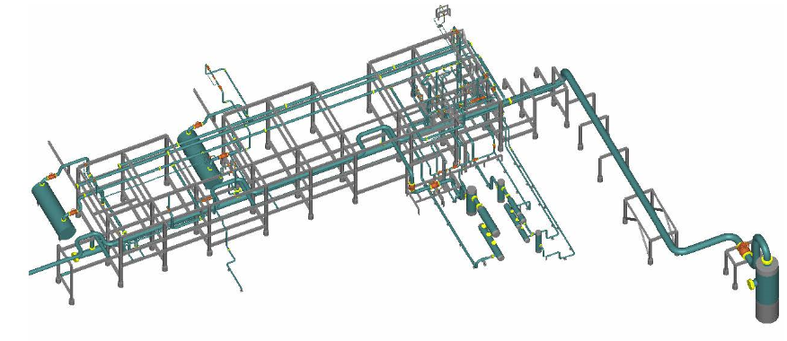
Piping Analysis Services
ASME B31.3 & B31.8

Slide 7
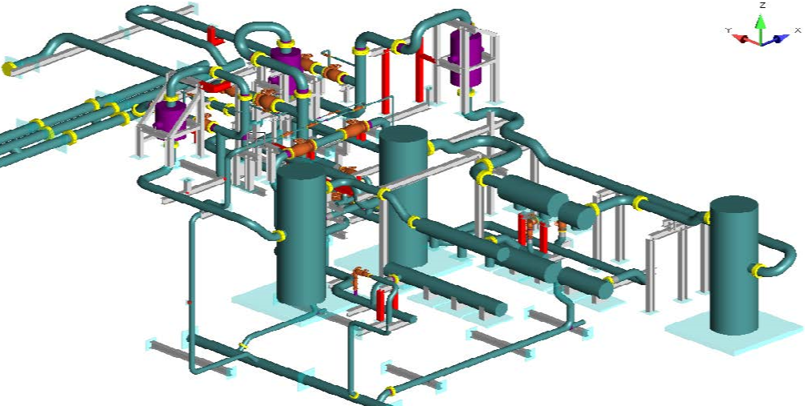
Piping Analysis Services
ASME B31.3
ASME B31.3 & B31.8

